Slide 1
EO Toolkit for Sustainable Cities and Human Settlements
Naledzani Mudau
South African National Space Agency
(EOToolkit partner)

Slide 2
Introduction
Collaborative effort between the Group on Earth Observations (GEO) Earth Observations for Sustainable Development Goals (EO4SDG) Initiative, UN-Habitat and many other international collaborators, to advance the New Urban Agenda and Sustainable Development Goal 11 to “make cities and human settlements inclusive, safe, resilient and sustainable.”

Slide 3
SDG Goal 11, targets and indicators
SDG 11: Make cities and human settlements inclusive, safe, resilient and sustainable.

Slide 4
Contribution of EO and GIS in SDG 11 reporting

Slide 5
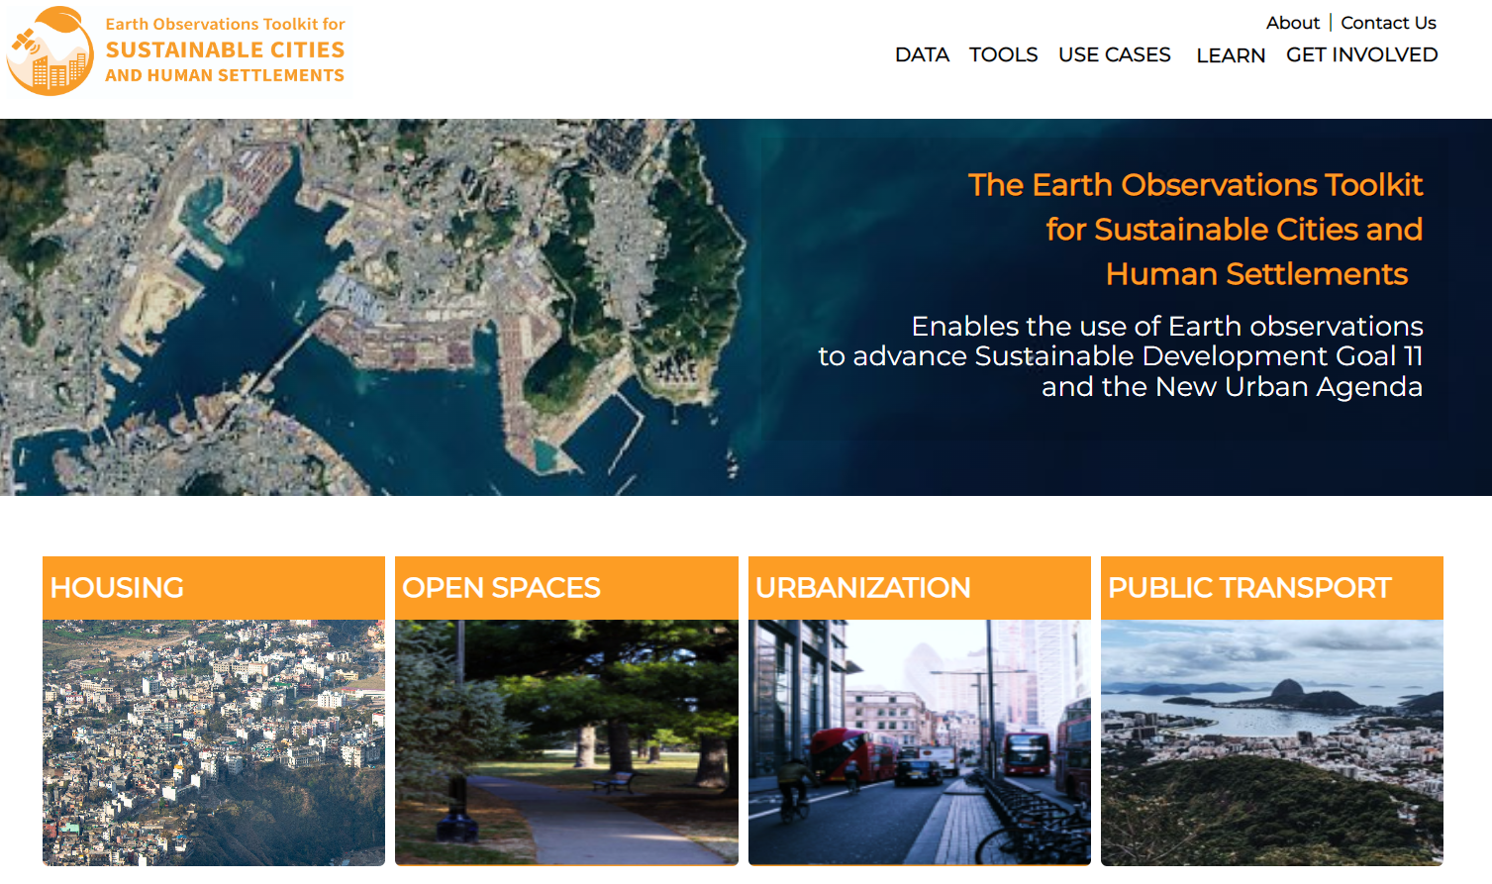
Objectives of the toolkit

Slide 6
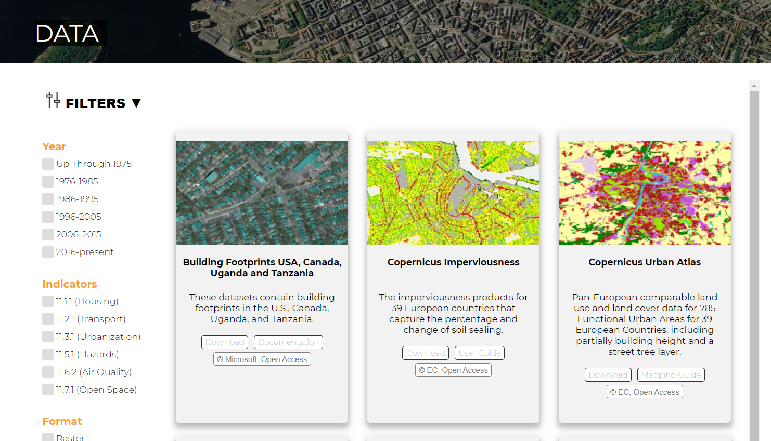
Available data

Slide 7
Available tools

Slide 8
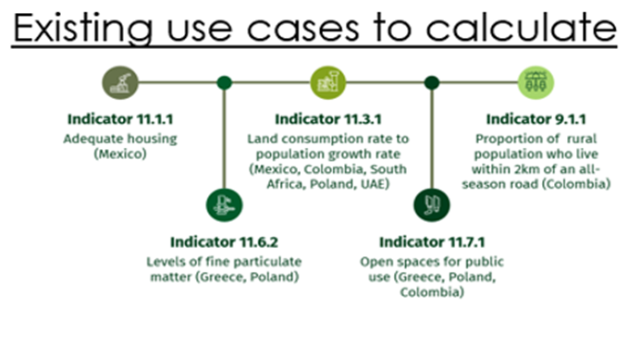
Case studies

Slide 9
Available resources

Slide 10
Get involved
https://eotoolkit.unhabitat.org/pages/contribute-to-the-toolkit

Slide 11
Thank you
Questions?

